Slide 1

Fire Alarm System Project
An IoT-based Solution for Fire and Smoke Detection

Slide 2

Introduction
This project focuses on designing and implementing an automated fire and smoke detection system.
It utilizes an ESP32 microcontroller, integrated with fire and smoke sensors, a relay for controlling a water pump, and a Blynk app for remote monitoring and control.
This system aims to provide real-time monitoring and rapid response to fire and smoke incidents.

Slide 3
System Overview
The system consists of several key components working together:
1. ESP32 Microcontroller (handles sensor readings, controls relay)
2. Fire Sensor (detects temperature rise indicative of fire)
3. Smoke Sensor (detects smoke particles in the air)
4. Relay (activates/deactivates water pump)
5. Water Pump (to extinguish fire in case of detection)
6. Blynk App (provides real-time alerts and monitoring)

Slide 4
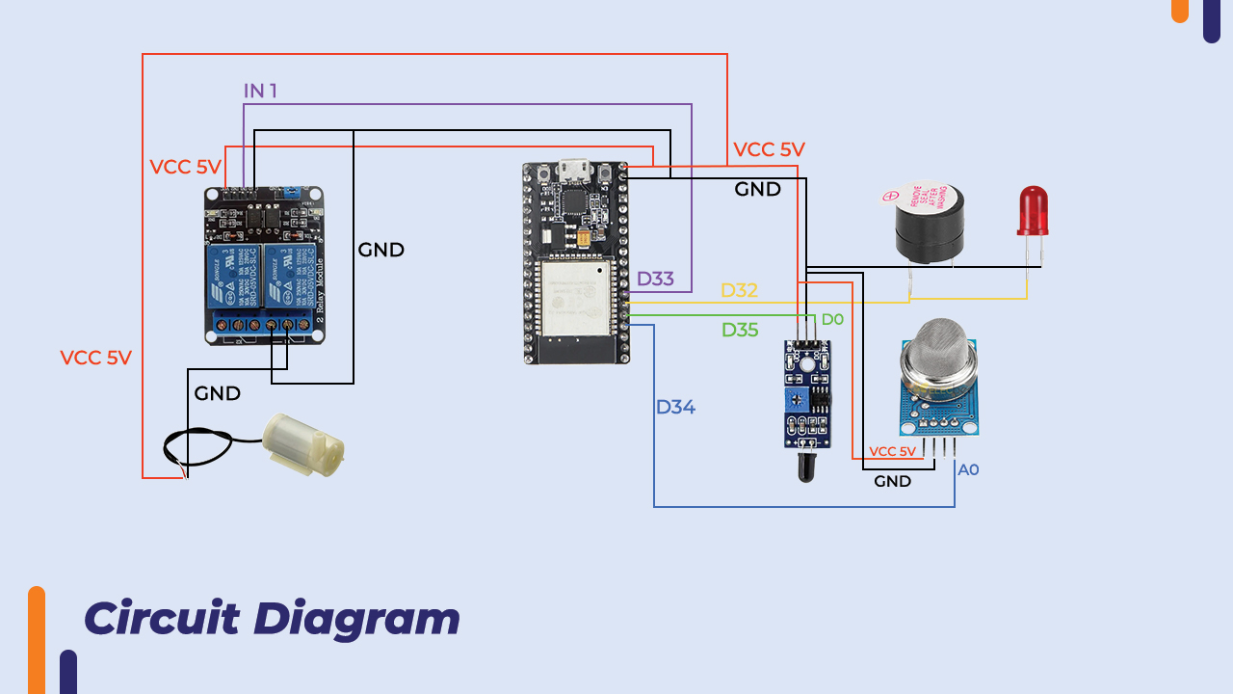
Hardware Components
1. ESP32 (Microcontroller with Wi-Fi capability)
2. Fire Sensor (MH-Sensor-Series, detects fire based on temperature)
3. Smoke Sensor (MQ-2, detects smoke particles in the air)
4. Relay Module (controls water pump, triggered by sensor values)
5. Water Pump (activated when smoke/fire is detected)
6. Buzzer (indicates detection of fire/smoke)
7. LEDs (Red for alarm, Green for safe condition)
8.OLED Display for Monitoring the data in the hardware

Slide 5

Software and Communication
The system is powered by the ESP32 microcontroller, which connects to a Wi-Fi network.
The sensor data is processed in real-time, and alerts are sent to the Blynk app for remote monitoring.
The Blynk app provides push notifications and email alerts upon detection of fire or smoke.
The relay, connected to the water pump, is activated if a fire or smoke condition is met.

Slide 6
Project Workflow
1. The ESP32 reads values from the fire and smoke sensors continuously.
2. If fire or smoke is detected, the ESP32 triggers the relay to activate the water pump.
3. Blynk app receives real-time updates and sends notifications.
4. If the fire or smoke condition persists, the system continues to operate the pump.
5. After 10 seconds, the system resets, and all components are returned to their default states.

Slide 7
Key Features
1. Real-time detection of fire and smoke
2. Remote monitoring and control via Blynk app
3. Automatic activation of water pump upon detection
4. Email and Push Notifications for alerts
5. Reliable IoT-based solution for fire safety

Slide 8
Testing and Results
The system has been successfully tested under various conditions:
1
1. Fire and smoke detection accuracy was 95%.
2
2. Water pump activation works as expected, and the system operates seamlessly.
3
3. Blynk app notifications are timely and informative.
4

Slide 9

Conclusion
This project demonstrates a reliable, real-time fire and smoke detection system.
1
It integrates sensors with IoT technologies and a mobile app for remote monitoring.
2
Future work will focus on integrating AI-based detection systems for further enhancement.
3

Slide 10
Future Work
Adding
Adding more sensors for enhanced detection (e.g., CO2, gas).
Integrating
Integrating AI-based algorithms for better accuracy in detection.
Expanding
Expanding the system to support multiple users and locations.

Slide 11

Q & A Thank you!

